Slide 1






The Adventures of
Smartie the Penguin
Notes:
1
1

Slide 2




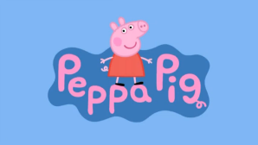












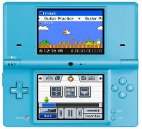



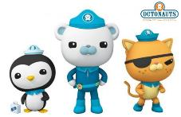
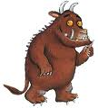

You might like…
Notes:
2

Slide 3
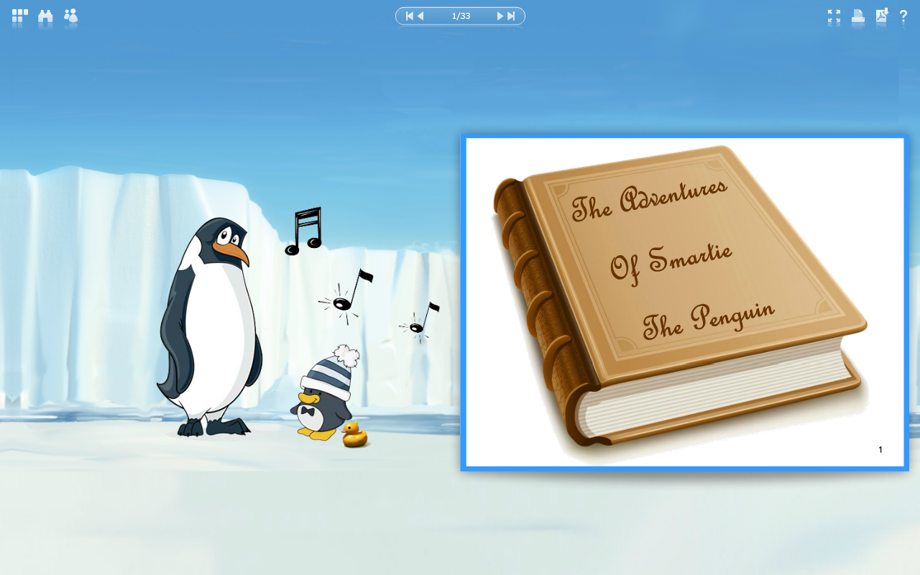




Notes:
3
3

Slide 4



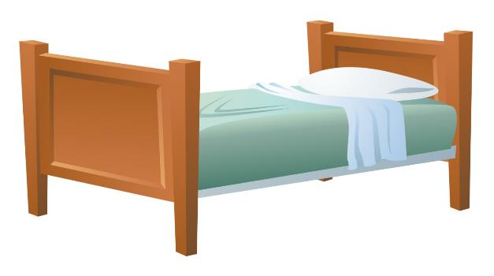




It was late at night and Smartie the penguin was WIDE awake… He was too excited to sleep because tomorrow was his birthday. He was really hoping to be given a new tablet!

Slide 5




The big day came and Smartie had really enjoyed his birthday party. He had saved his most exciting looking present until the end.
“Oh I really hope this is a tablet of my own!” he thought as he began to open it.

Slide 6




Smartie tore off the wrapping paper in a hurry! Mummy and Daddy Penguin had bought him a brand new tablet. Just what he wanted!
“Oh! Thank you, thank you, thank you!”

Slide 7





Smartie’s parents enjoy using the internet and are always there to help Smartie.
Smartie was allowed to play a game on his tablet once in the morning and once in the afternoon.
Mummy Penguin helped Smartie to find his favourite game and he was off!

Slide 8



£
Everything was going well and Smartie was having a super time when all of a sudden… something very strange happened.
A picture popped up on to the screen. It was colourful and Smartie didn’t know what to do.

Slide 9



“Oh no!” thought Smartie. “Did I click the wrong buttons? Have I broken the tablet? Are mummy and daddy going to be cross with me?”
Oh no! What happened?
£

Slide 10





Can you help Smartie make the right decision?
Should he try to fix the problem by himself and get rid of the picture, or should he ask his parents for help?
Time to chat

Slide 11


HELP!!
“Help!” cried Smartie. “Daddy, mummy, please help me! Something has gone terribly wrong. There’s a funny picture on my screen and I don’t know where it came from.”

Slide 12

Well done Smartie!
“Well done Smartie,” said Daddy Penguin.
“What a CLEVER little penguin you are!
Well done for asking for help and not trying to fix it by yourself.”

Slide 13


Mummy Penguin was so pleased with what Smartie had done, she taught him a song to help him make sensible choices on the internet in the future…

Slide 14

Sing with me!
Before you tap and click…
You need to stop and think…
And TELL someone!

Slide 15






Mummy Penguin deleted the picture that had popped up and Smartie continued to play on his tablet.

Slide 16





The next morning, Smartie rushed downstairs to play a game online. Daddy Penguin was already up and about, reading his newspaper in the kitchen.
Smartie went on to the internet but something had changed…

Slide 17




This wasn’t right! Smartie was very confused… “Hang on a minute,” he thought to himself, “I know what has happened! My big brother Bertie has been using my tablet without asking me!”

Slide 18



Smartie knew that this was a website for much older children. He thought that he might know what to do to find his favourite game, and which buttons to press, but on the other hand he wasn’t too sure.

Slide 19


What should Smartie do?
Should he try to find the right website by himself or should he ask for help?
Time to chat

Slide 20



Let’s help Smartie to make the right decision by singing Mummy Penguin’s song! One, two, three…

Slide 21


All sing together!
Before you tap and click…
You need to stop and think…
And TELL someone!

Slide 22


“Help!” shouted Smartie. “Mummy, daddy, please help me. I’m trying to find my game but Bertie changed it! ”
“Smartie,” replied Mummy Penguin, “you are a SUPERSTAR! You did just the right thing by asking for help and not trying to find the website by yourself.”
HELP!!

Slide 23





Mummy Penguin helped Smartie get back to his game and everything was fine again.
Later on that afternoon…
Can you guess what Smartie was doing?

Slide 24



That’s right! Smartie was back playing online with his friends, trying to get to the top of the leader board. He was getting better and better at his favourite game.

Slide 25

All of a sudden, the other players started saying unkind things and being mean to Smartie’s friend Percy. One player said “you’re not very good at this game, are you?”
You’re not very good!
Haha

Slide 26

You can’t play anymore!
Time to chat
The other player continued to talk. “I don’t want you playing our game anymore” they teased. Percy quickly left the game and Smartie felt sad. He didn’t understand why they were being mean to Percy.

Slide 27


What should Smartie do?
Should he just ignore the messages and do nothing or should he tell mummy and daddy instead?
Time to chat

Slide 28



Let’s help Smartie to make the right decision by singing his special song! One, two, three…

Slide 29
Let’s sing together!
Before you tap and click…
You need to stop and think…
And TELL someone!

Slide 30



“Daddy Penguin! Mummy Penguin!” called Smartie.
“The other players are being mean to Percy and not letting him join our game. What shall I do?”
“Oh Smartie, you have been so SENSIBLE,” said Daddy Penguin.

Slide 31


“Unfortunately not everyone is nice on the internet and sometimes other players can say mean things. If this happens to you or one of your friends then you should always tell us and we can help by blocking the player.
Remember it is just as important to be nice to someone online as it is in the real world. We want everyone to feel welcome and happy when using the internet.”
Block

Slide 32




From that day on, Smartie the penguin always knew how to be safe when using his tablet and playing on the internet!

Slide 33



If anything happened that made him feel worried, upset or confused he didn’t try to fix things by himself…
You can’t play anymore!
£

Slide 34

Time to chat
He stopped…
thought about what to do…
and always asked an adult for help.

Slide 35





Sing with us!
Before you tap and click…
You need to stop and think…
And TELL someone!

Slide 36



Smartie’s message to you
I am very lucky because I have mummy and daddy penguin to help me! But who can help you?
Time to chat

Slide 37

Notes:
37
37

